Slide 1
ERP Systems
Ayaz Hasan (20k-1044)
Ferdeen Bakht (20k-0219)
Arsalan Munir (20k-1718)
Instructor : Miss Sobia Iftikhar

Slide 2
Definition of ERP
Enterprise Resource Planning (ERP) is a software that enables different technological applications to integrate and share information.
It is used in organizations to facilitate the information from different departments, processes and functions.
Most organizations use ERP for their business processes.

Slide 3
ERP Tools
SAP
NetSuit
TallyPrime
MS Dynamics 365
etc.

Slide 4
ERP Tool in Amazon
Amazon has been using SAP as its ERP system.
Implemented modules of SAP in Amazon:
SAP basis
SAP business suit
SAP businessObjects
SAP Mobility

Slide 5
Why Amazon Use ERP
Originally started as an online bookselling company.
Before using SAP, Amazon managed its ERP through a combination of custom-built systems and third-party solutions. The company used a variety of in-house tools to manage key business processes.
In 2008, Amazon Start using Sap.

Slide 6
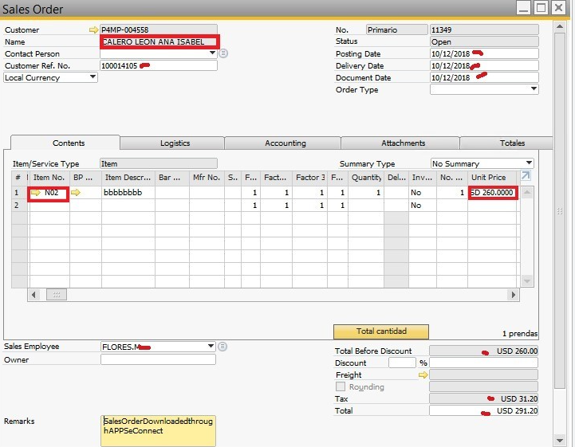
Benefits of Amazon ERP System:
Efficient management of product listing

Slide 7
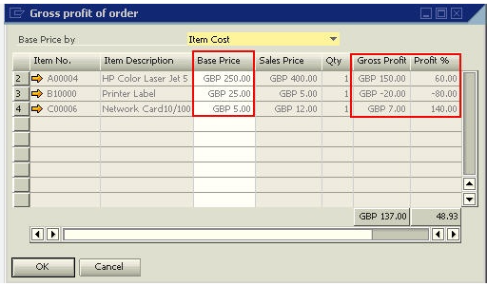
Benefits of Amazon ERP System:
the advanced profitability determination features offered by ERP systems manage all costs, as well as, connect them to the sales; thereby enabling Amazon sellers to determine the Gross profit/product easily.

Slide 8
Workflow of Amazon SAP ERP
Financial Accouting:
Transactions are recorded in SAP ERP and posted it to general ledger.
This information used to generate reports i.e balance sheets, income statements.

Slide 9
Workflow of Amazon SAP ERP
Supply Chain Management:
Orders are entered into SAP ERP.
System automatically generates purchase orders for suppliers.
It tracks inventory levels and generates reports.

Slide 10
Workflow of Amazon SAP ERP
Manufacturing:
It manages the entire manufacturing process, from product design to production and delivery.
It tracks materials and resources.
It generates reports to help amazon manage their manufacturing operations.

Slide 11
ERP Tool in Starbucks
Starbucks uses Oracle ERP system to automate their business processes, e.g Supply Chain, Finance, Project Management.
It provides:
Operational Reports
Sales and Revenue Data
Expense analysis
Stock management metrics

Slide 12
ERP Tool in Starbucks
Oracle ERP allows the chain to maintain minimal stocks while:
Meeting Customer Demand
Tracing deliveries
It maintains the efficiency in the process.

Slide 13
Advantages of ERP systems
Business Integration
Improved customer service and order fulfillment
Improved communication with suppliers and customers
One common system - less duplication, more efficient
Reduce inventory
Saves enormous time and effort in data entry
Improved business performance

Slide 14
Disadvantages of ERP Systems
High software cost
Consulting Fees
Forced change of processes
Very complex software
Lack of trained people
Not internet-ready

